Slide 1
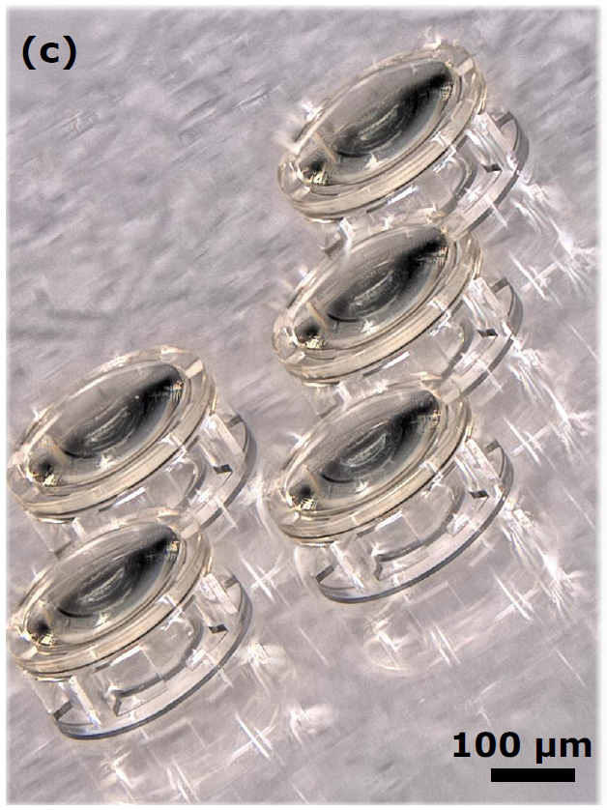
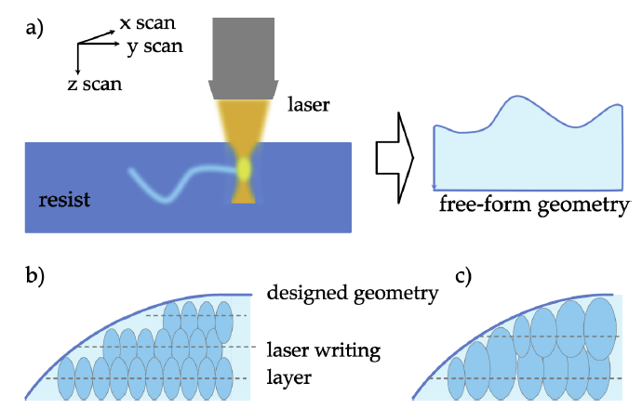
Advances in 2PP and Grey scale
Leo Jih-Liang Hsieh
LAPD and LO, EPFL

Slide 2
Two-photon polymerization (2PP)
Two-photon grayscale lithography (2GL)

Slide 3
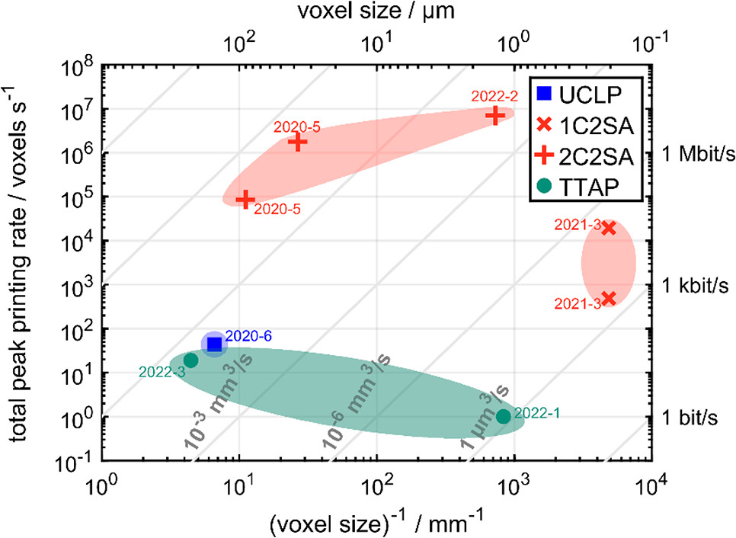
Comparing 3D Printers - Speed vs. Voxel
https://doi.org/10.1021/acsphotonics.2c01632

Slide 4
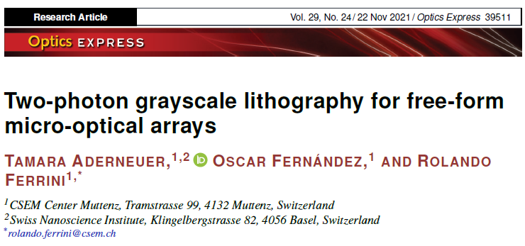
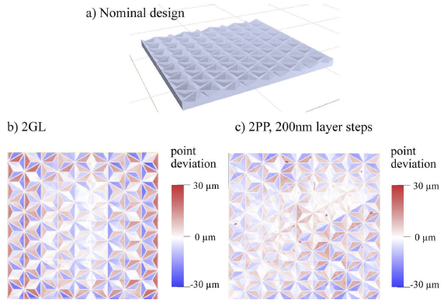
2GL on Freeform Micro-Mptical Arrays (FMOAs)
https://doi.org/10.1364/OE.440251

Slide 5
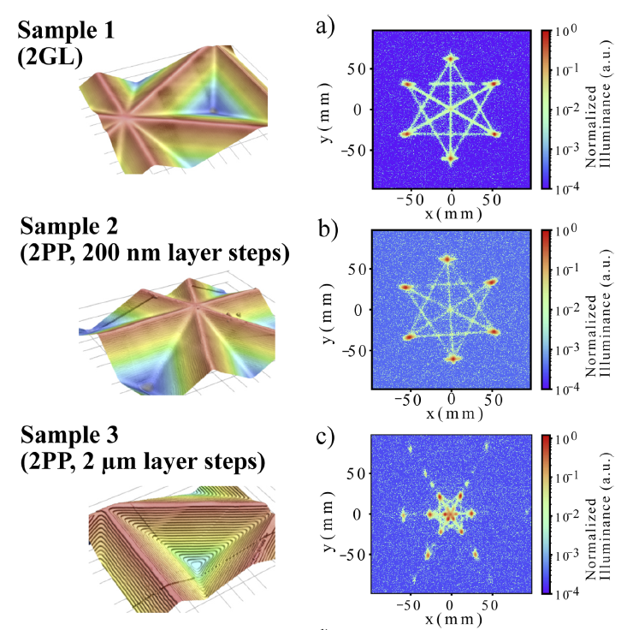
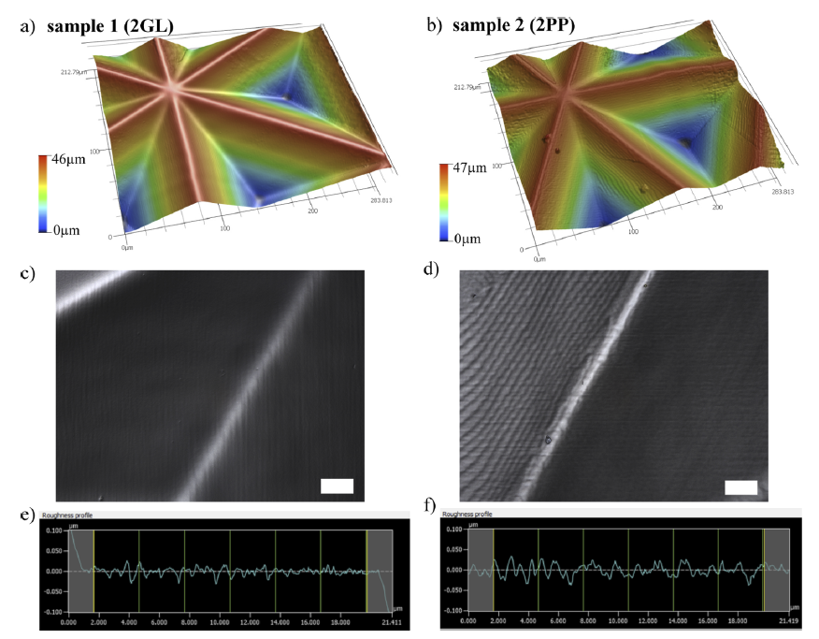
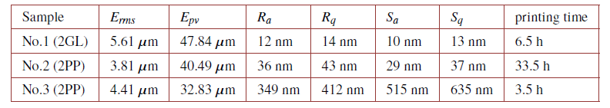
2GL on Freeform Micro-Mptical Arrays (FMOAs)
1330848 measured points
1331114 measured points
https://doi.org/10.1364/OE.440251

Slide 6
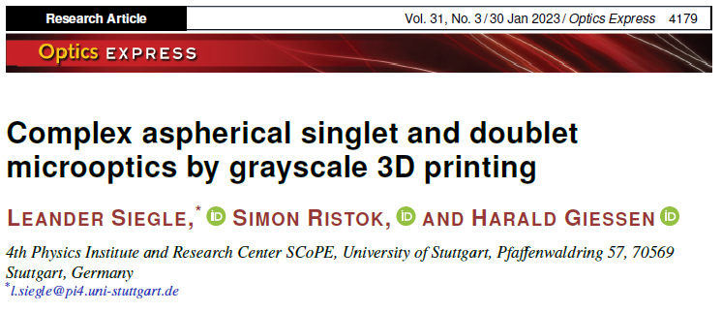
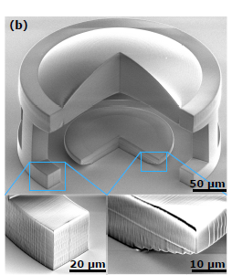
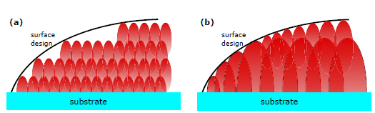
2GL on Aspherical Ainglet and Doublet
https://doi.org/10.1364/OE.480472

Slide 7
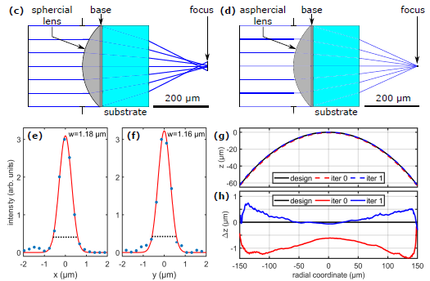
2GL on Aspherical Ainglet and Doublet
https://doi.org/10.1364/OE.480472

Slide 8
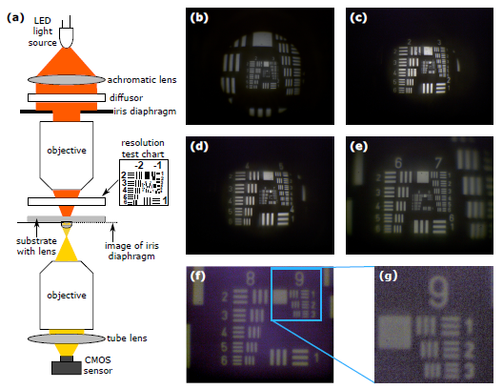
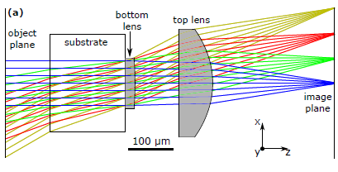
2GL on Aspherical Ainglet and Doublet
field of view of 60°
deviations 20 nm for the bottom lens
deviations 100 nm for the larger top lens
resolution 645 lp/mm
https://doi.org/10.1364/OE.480472

Slide 9
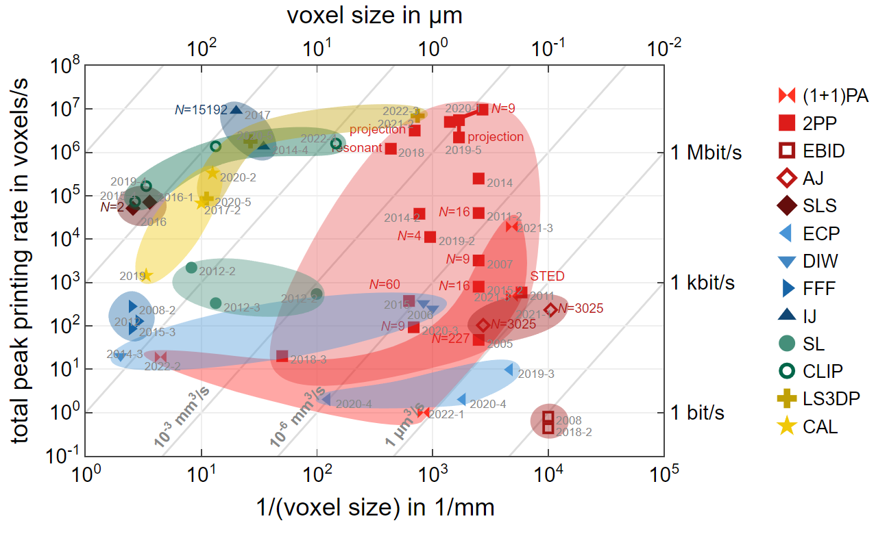
Comparing 3D Printers - Speed vs. Voxel
(1+1)PA: (1+1)-Photon Absorption
2PP: Two-Photon Printing
EBID: Electron Induced Deposition
AJ: Aerosol Jet 3D Nanoprinting
SLS: Selective Laser Sintering
ECP: Electrochemical Printing
DIW: Direct Ink Writing
FFF: Fused Filament Fabrication
IJ: Inkjet Printing
SL: (Projection Micro-)Stereolithography
CLIP: Continuos Liquid Interphase Printing
LS3DP: Light-Sheet 3D Printing
CAL: Computed Axial Lithography
https://3dprintingspeed.com/

